Slide 1
SOCIAL MEDIA ADVERTISING POWERPOINT PRESENTATION
Enter u name

Slide 2


Social Media Ad Classification
Social media advertising has revolutionized digital marketing. It offers unprecedented targeting capabilities and engagement opportunities. Understanding ad types and strategies is crucial for marketing success in today's digital landscape.

Slide 3

Abstract
The classification of social media advertisements has become a critical task in digital marketing and e-commerce. This project presents a machine learning approach to classify social media ads based on user interactions, demographic information, and engagement data. The model aims to predict whether an ad will result in a purchase based on features such as user age, gender, estimated salary, and previously observed engagement patterns.
Using a dataset of social media ad interactions, several machine learning algorithms, including logistic regression, decision trees, and support vector machines (SVM), were implemented and compared for performance. Data preprocessing steps such as feature scaling and handling missing values were applied to ensure robust model performance. The project evaluates model accuracy, precision, and recall, aiming to identify the optimal classification model. The results suggest that the use of machine learning in ad classification can significantly improve targeting and marketing efficiency, leading to higher conversion rates and better customer engagement.

Slide 4





Types of Social Media Ads
Display Ads
Video Ads
Eye-catching banners and images across social feeds. They grab attention with vivid visuals and concise messaging.
Engaging short-form or long-form video content. These captivate audiences with motion and sound.
Carousel Ads
Sponsored Content
Multiple images or videos in a single ad. Great for showcasing product features or telling a story.
Brand-promoted posts appearing like organic content. These blend seamlessly into users' feeds for a native experience.

Slide 5




Platform-Specific Ad Classification
Facebook & Instagram
LinkedIn
TikTok
Feed ads, stories, and shopping ads. Robust targeting options based on interests and behaviors.
Text ads, sponsored content, and InMail. B2B-focused, targeting professionals by job roles and industries.
Video ads and hashtag challenges. High engagement with younger audiences through creative, short-form content.

Slide 6


AI & Machine Learning in Ad Classification
1
Algorithmic Targeting
Platforms use ML to optimize ad delivery based on user behavior and preferences.
2
Creative Generation
AI tools like ChatGPT help generate ad copy and A/B testing variations.
3
Fraud Detection
AI detects fraudulent clicks and impressions, protecting advertisers' budgets from waste.
4
Sentiment Analysis
AI-driven tools classify user responses to measure ad effectiveness and engagement levels.

Slide 7

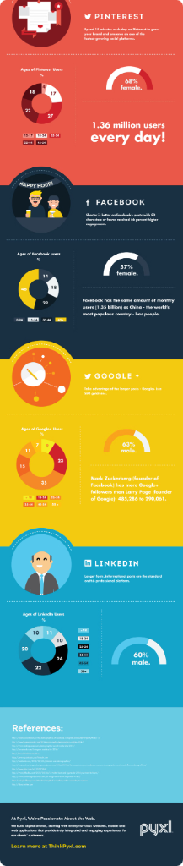




Ad Formats and Best Practices
Mobile-First Design
Over 90% of social media ad views are on mobile devices. Optimize for small screens.
Video Content
Platforms prioritize video, especially vertical formats. Create engaging, short-form video ads.
Personalization
Tailor ads to user behavior for higher click-through rates. Use dynamic content when possible.
Clear CTAs
Use simple, actionable messages to drive conversions. Make next steps obvious for users.

Slide 8


Future Trends in Social Media Ads
1
AI-Powered Optimization
2
AR/VR Integration
Increased use of AI for predictive analytics and real-time ad adjustments. Expect more personalized and efficient campaigns.
Growth of augmented and virtual reality ads. Allow users to try products virtually before purchase.
3
Micro-Influencer Partnerships
4
Seamless Shopping Experiences
Rise of niche influencers with highly engaged audiences. Authentic content resonates more with targeted groups.
Increase in shoppable ads integrated directly into platforms. Users can purchase without leaving their favorite apps.

Slide 9

Conclusion :
In a rapidly evolving digital landscape, social media ad
classification is critical to a successful marketing strategy. Advertisers must leverage platform-specific features, apply AI for better targeting and optimization, and stay ahead of emerging trends to remain competitive. Understanding how to classify and strategically use various ad formats will allow brands to connect more meaningfully with their audience and achieve their marketing goals.

Slide 10
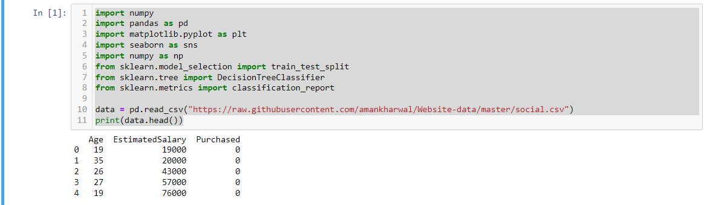

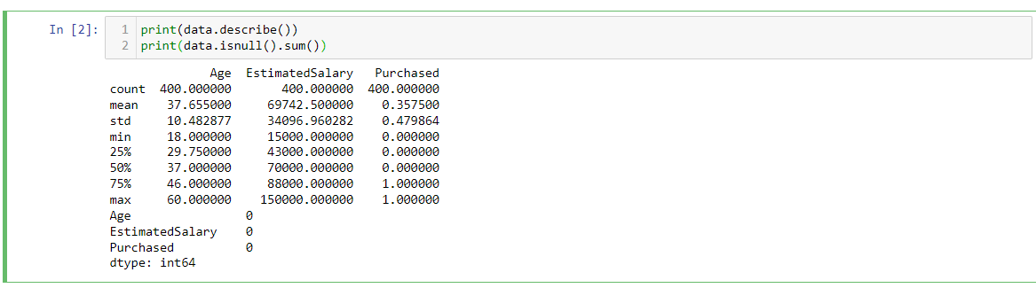

Slide 11
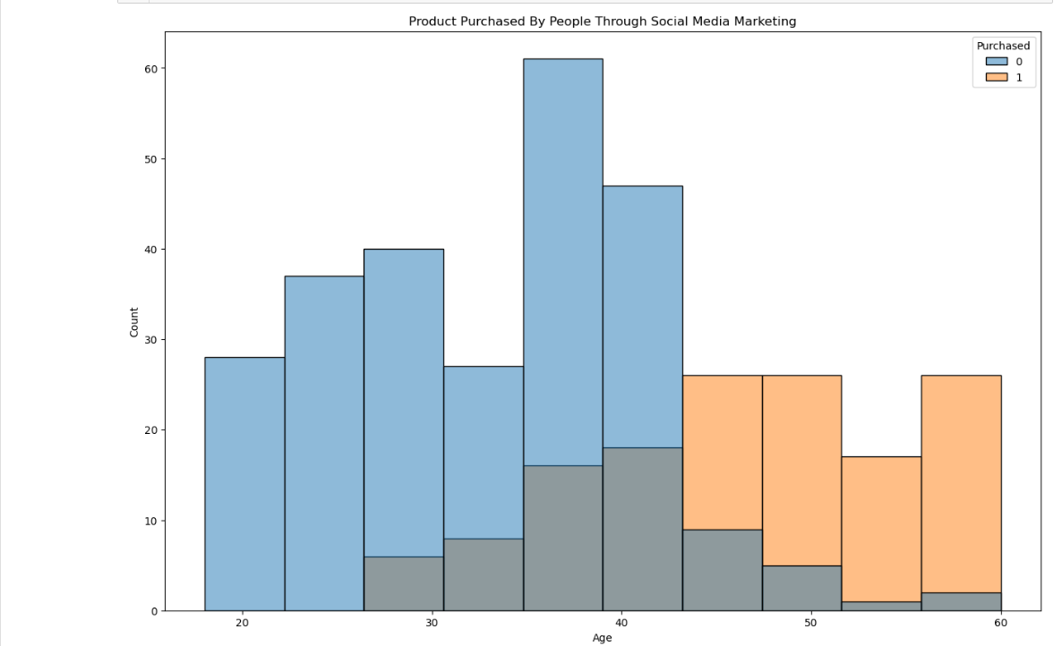

Slide 12
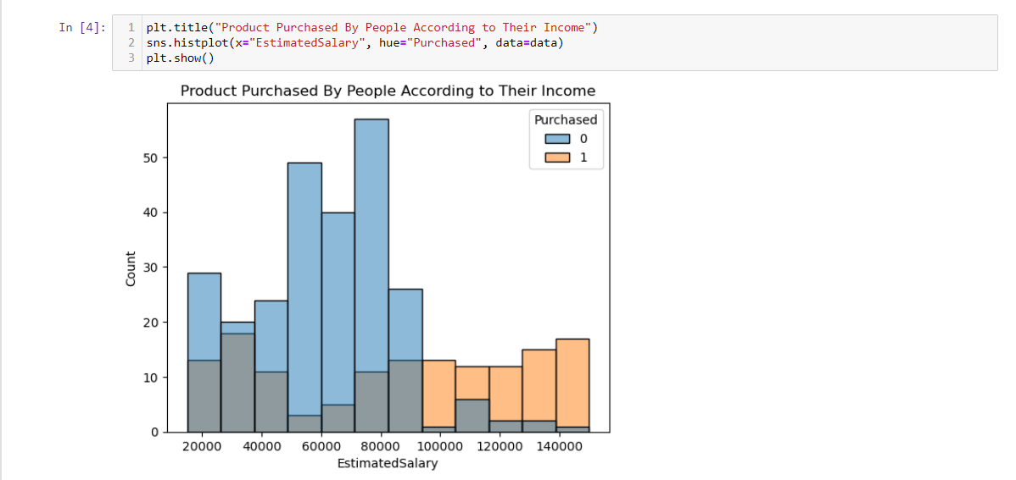

Slide 13
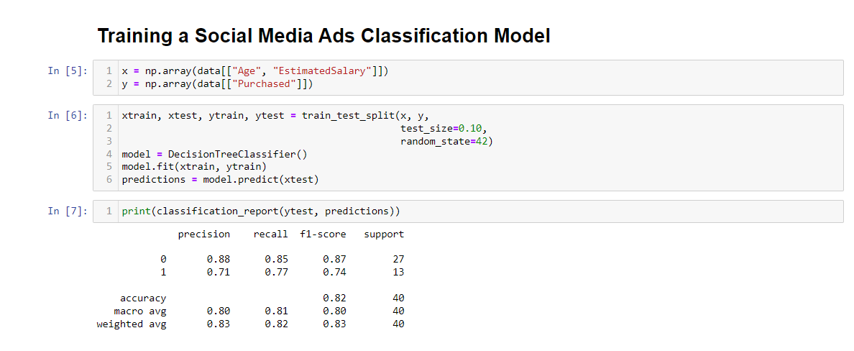


Slide 14


